Slide 1

Residential Property Sales Analysis
1/21

Slide 2
Team members:
Roshini Bandi (Team Leader) Saikrishna Chigicherla
Data Engineer Data Scientist
Vamshi Reddy Thatikonda Geethika Myneni
App Development Data Modeling
2/21

Slide 3
Introduction
House Price prediction models are crucial for data-driven decision-making, guiding strategic choices and resource allocation.
They play a pivotal role in optimizing operations across various industries, ensuring efficiency and cost-effectiveness.
These models provide a competitive edge by enabling businesses to anticipate and respond to market dynamics, influencing success in areas like marketing, sales, and real estate.
3/21

Slide 4

Questions:
1.Did COVID-19 have an impact on residential sale prices? If so how big was that impact?
2.Which variables have an impact on sale price, and how strong is that impact?
4/21

Slide 5
Solution:
1.We used “Talend ETL ” tool for cleaning the data and “snowflake” as database.
2. We built a Machine learning model “Linear Regression” and deployed the model as flask application into AWS
5/21

Slide 6
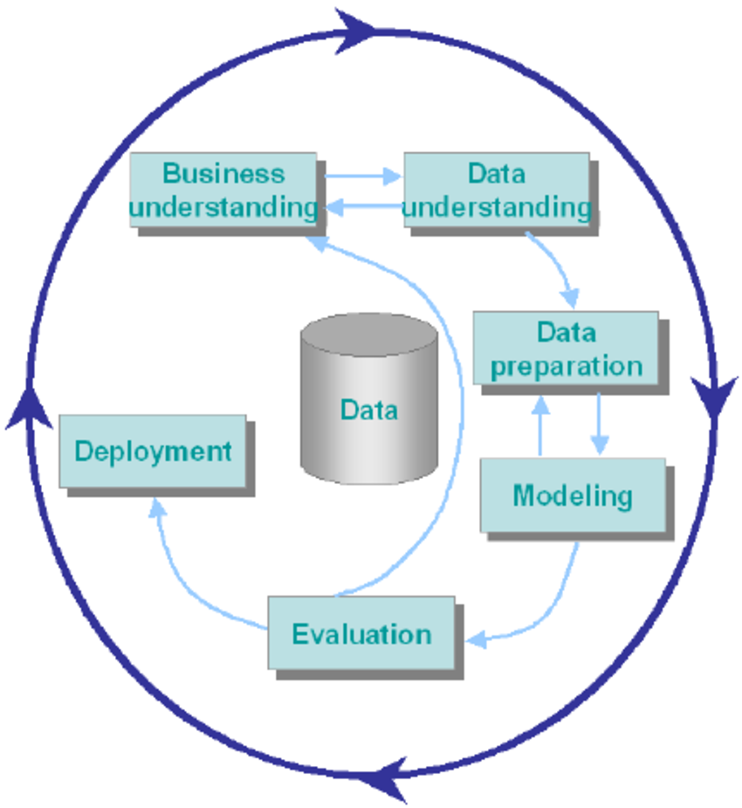
CRISP-DM METHODOLOGY:
6/21

Slide 7
Business Understanding
Focused on enhancing user/buyer experience by providing valuable insights into retail price values.
7/21

Slide 8
Data Understanding:
Data comes from Open Data source and describes the sale history for active properties listed among the District of Columbia’s real property tax assessment roll.
The dataset contains 108,552 records and 39 columns, describing property attributes, such as area and number of bedrooms, as well as sale information such as sale price and date.
8/21

Slide 9
Data Preparation:
•We have collected the data from open source and uploaded into git.
•Used Talend ETL to read the data from git and transform the data and then upload modified data into snowflake.
•Performed EDA (Exploratory Data Analysis) on the input data.
9/21

Slide 10
Modeling and Evolution
•Build a Linear regression model, by taking different variable to predict the accuracy of sales price.
•Used a Flask application, so that user can enter the input values (House Variables) and get the output(Predicted house price)
10/21

Slide 11
Deployment
•The model was deployed using AWS (Amazon Web Services).
11/21

Slide 12
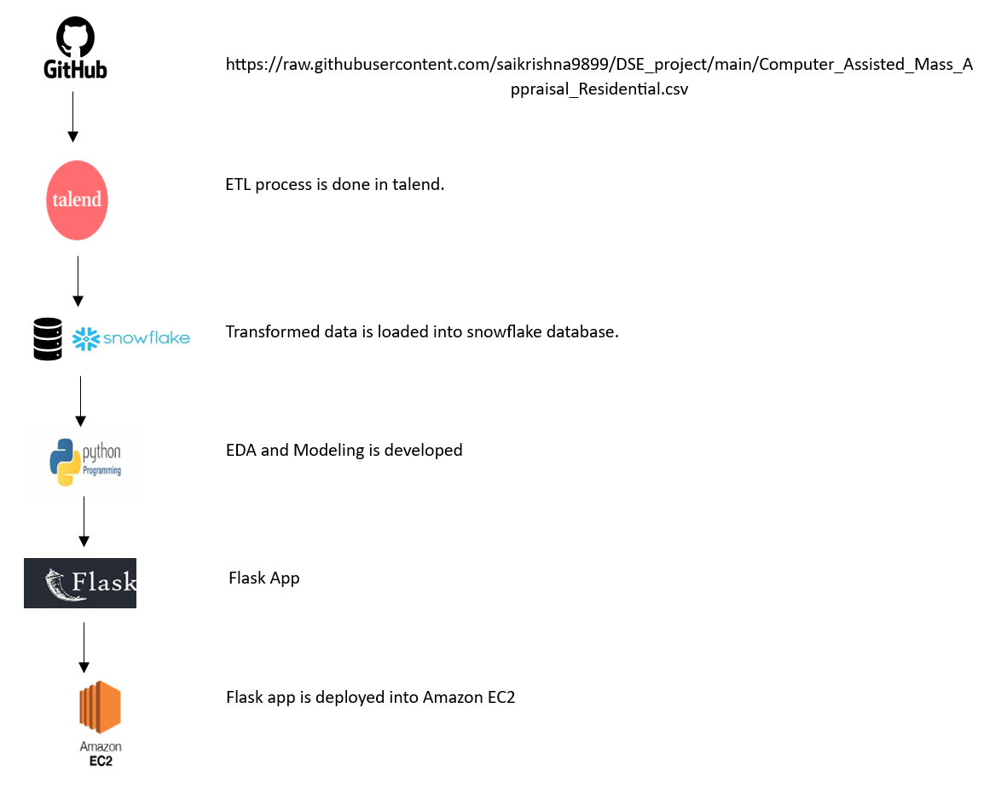
Data Pipeline:
12/21

Slide 13
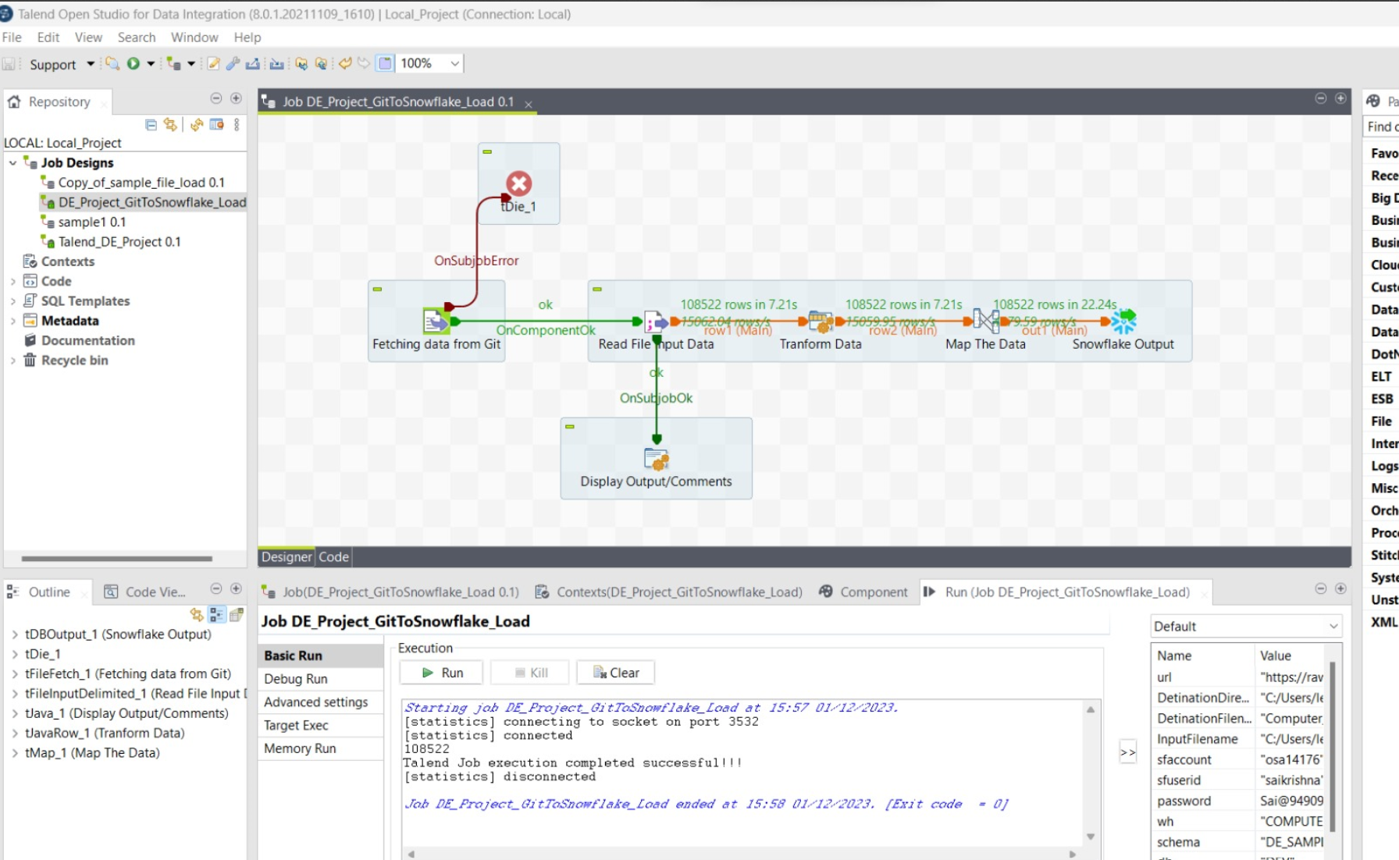

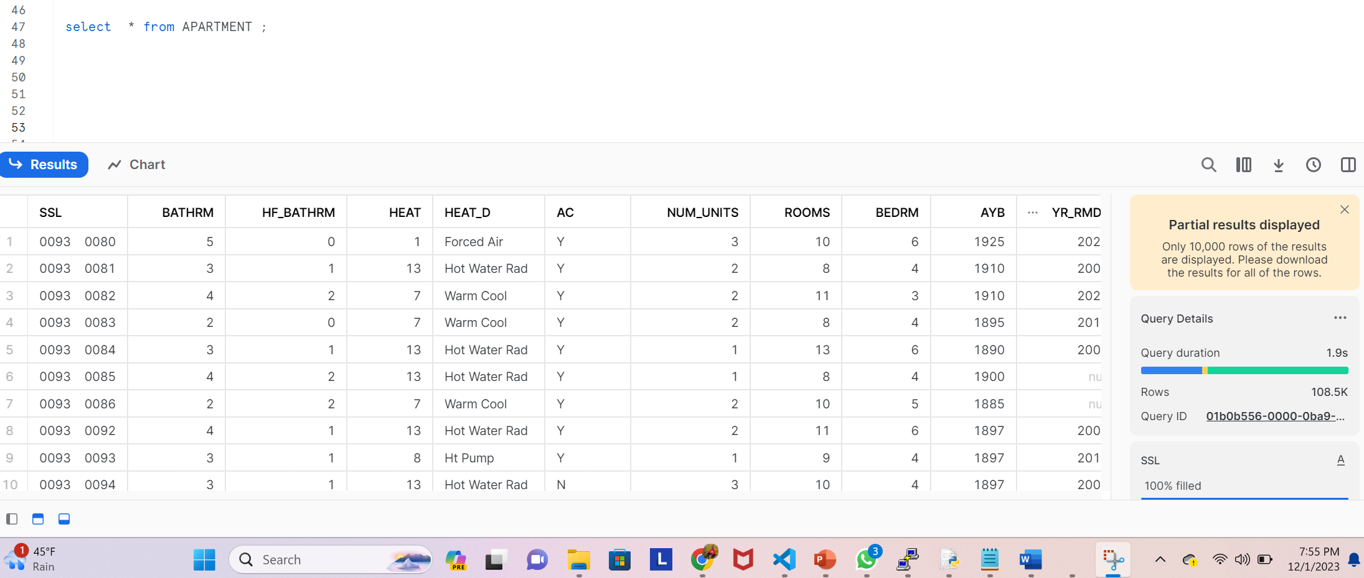

Outputs:
Executed the Talend ETL code, Data got loaded from Git to Snowflake database
Data loaded into snowflake
13/21

Slide 14
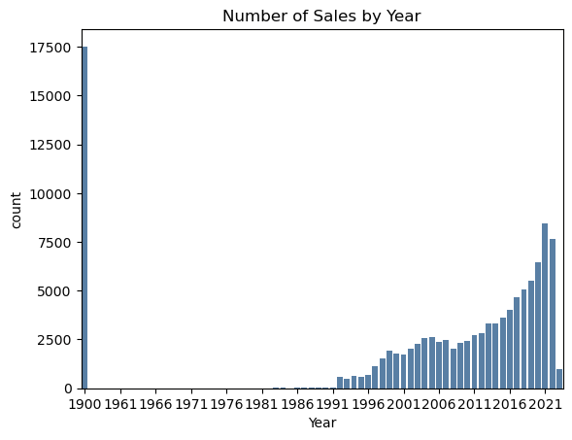
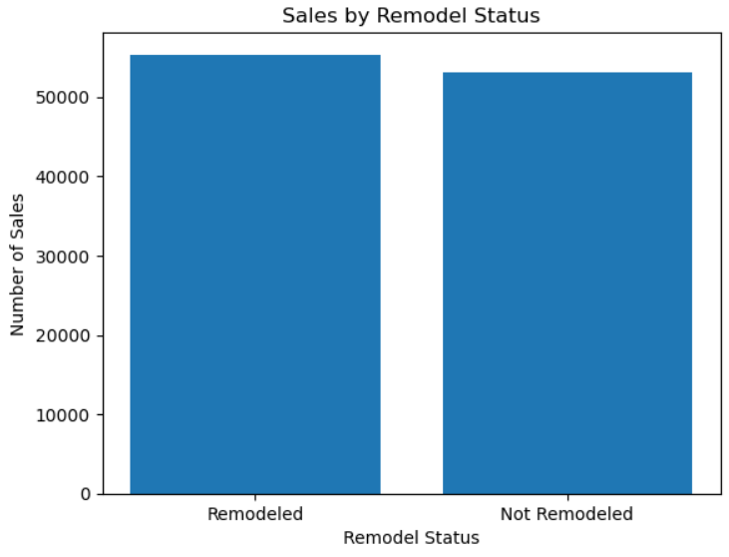
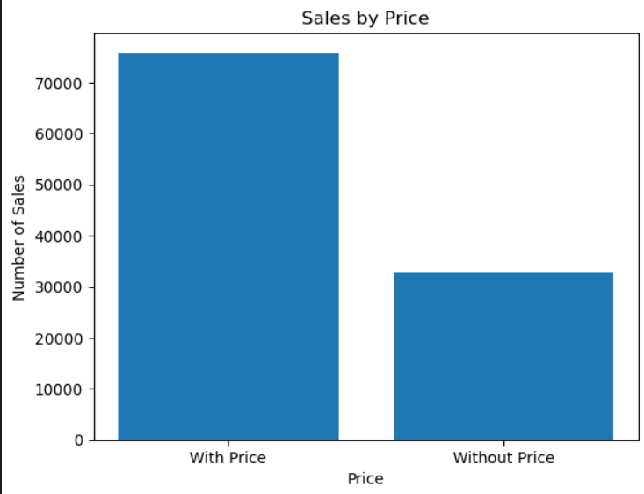
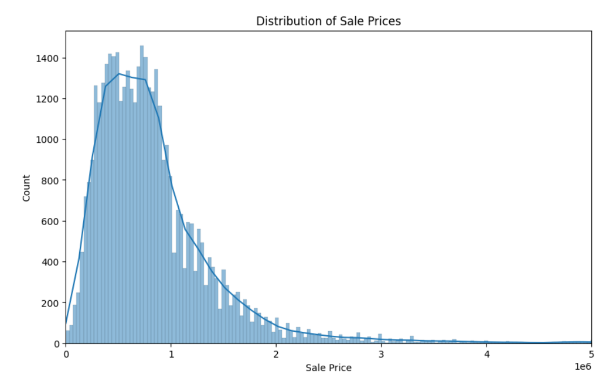
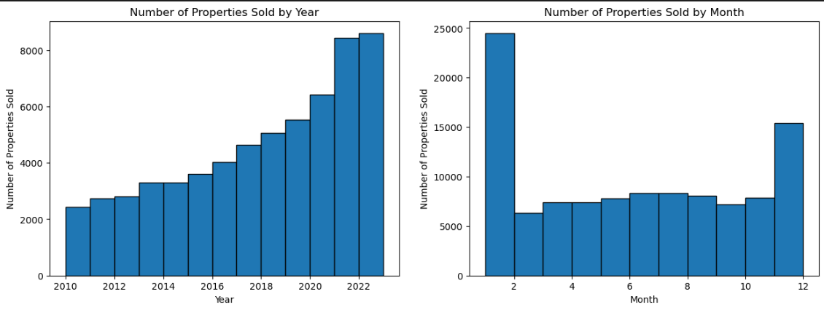
Distribution of Sales
EDA(Exploratory Data Analysis)
14/21

Slide 15
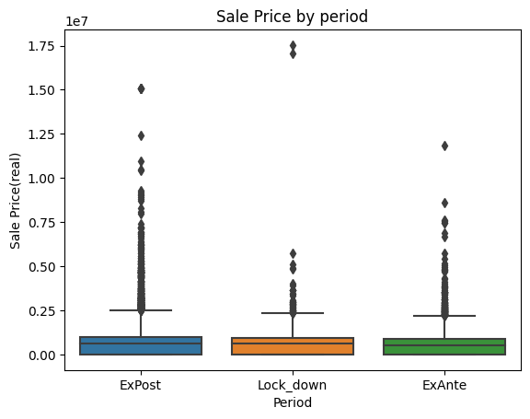
Covid impact
In comparing the house price levels with the number of bedrooms, and the number of bathrooms, the condition of house, there seem to be different price levels between the three periods.
15/21

Slide 16
Covid impact
In comparing the house price levels with the number of bedrooms, and the number of bathrooms, the condition of house, there seem to be different sales volume between the three periods.
16/21

Slide 17
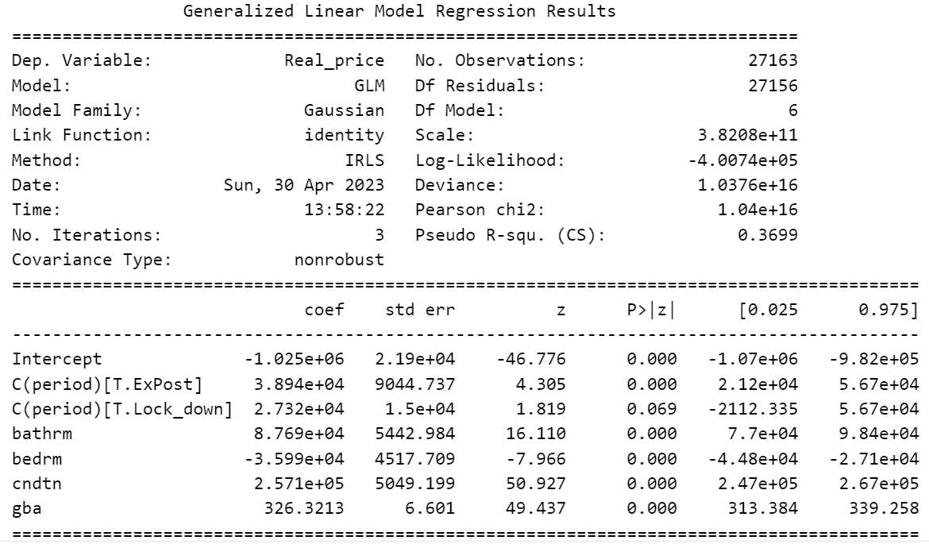
Covid impact
The period has positive impact on housing price.
Compared Ex-ante period, whether during or after Covid, housing price increased.
17/21

Slide 18
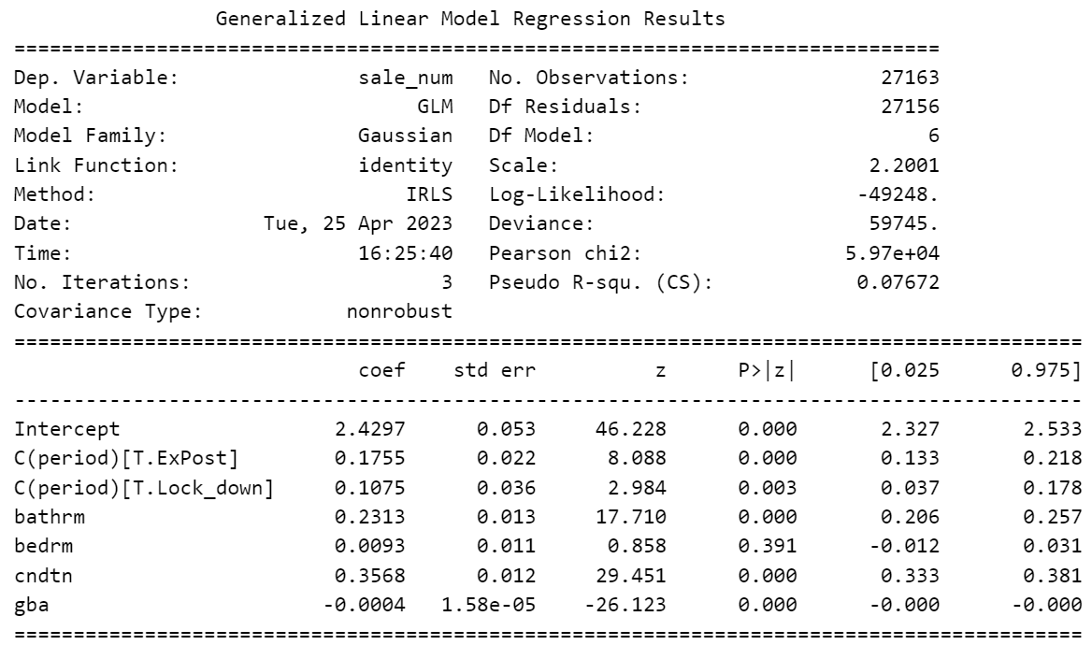
Covid impact
The period has positive impact on sales volume.
Compared Ex-ante period, whether during or after Covid, sales volume increased.
18/21

Slide 19
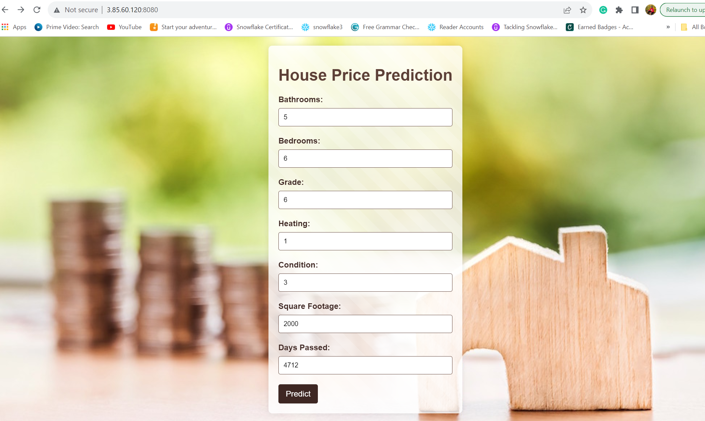
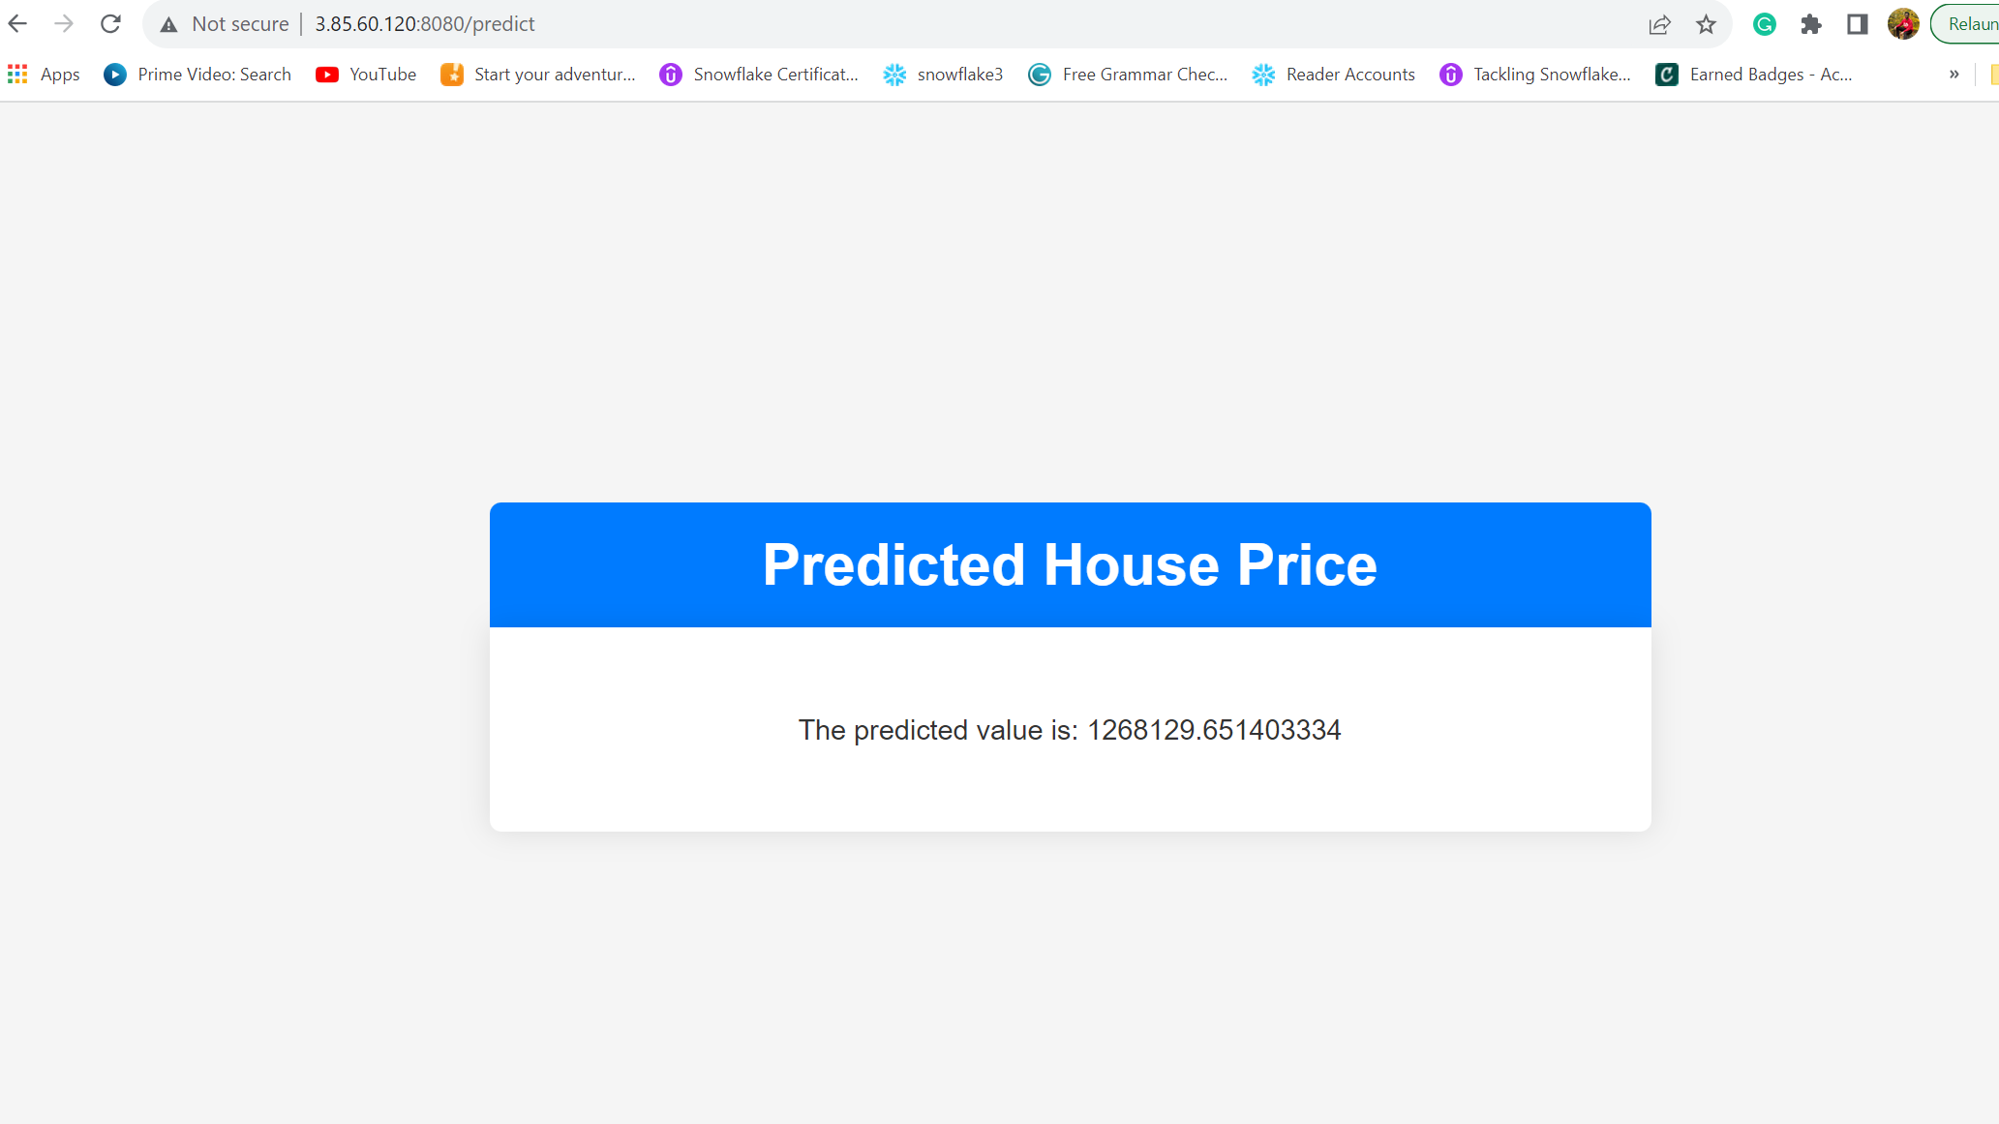
Distribution of Sales
AWS Web Application Results
Input
Output
19/21

Slide 20

Demo of the Application
20/21

Slide 21

21/21

